Slide 1
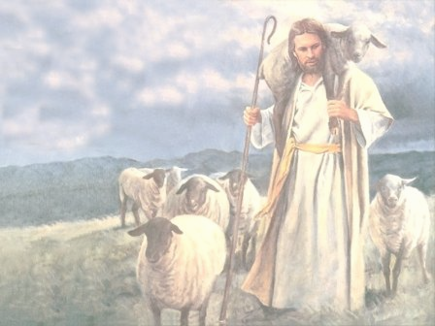
THE GREAT SHEPHERD
“Caring for His Sheep”
Psalm 23

Slide 2
Psalm 23
The Lord The Shepherd of His People
A Psalm of David.
1The Lord is my shepherd; I shall not want.
2He makes me to lie down in green pastures;
He leads me beside the still waters.
^{3 He restores my soul;}

Slide 3
He leads me in the paths of righteousness
For His name’s sake.
4 Yea, though I walk through the valley of the shadow of death,
I will fear no evil;
For You are with me;
Your rod and Your staff, they comfort me.

Slide 4
5 You prepare a table before me in the presence of my enemies;
You anoint my head with oil;
My cup runs over.
6 Surely goodness and mercy shall follow me
All the days of my life;
And I will dwell in the house of the Lord Forever.

Slide 5
John 10
1. The Good Shepherd Offers Security (10:1–6)
2. The Good Shepherd Offers Shelter (10:7–13)
3. The Good Shepherd Offers Salvation (10:14–21)
4. The Good Shepherd Offers Signature (10:22–30)
5. The Good Shepherd Offers Safety (10:31–42)

Slide 6
THE LORD’S CARE IN THIS LIFE vs. 1-3
1. Food

Slide 7
THE LORD’S CARE IN THIS LIFE vs. 1-3
1. Food
2. Refreshment

Slide 8
THE LORD’S CARE IN THIS LIFE vs. 1-3
1. Food
2. Refreshment
3. Forgiveness and Renewal

Slide 9
THE LORD’S CARE IN THIS LIFE vs. 1-3
1. Food
2. Refreshment
3. Forgiveness and Renewal
4. Direction and Guidance

Slide 10
THE LORD’S CARE IN DEATH vs. 4
1. Shadow

Slide 11
THE LORD’S CARE IN DEATH vs. 4
1. Shadow
2. Valley

Slide 12
THE LORD’S CARE IN DEATH vs. 4
1. Shadow
2. Valley
3. Walk

Slide 13
THE LORD’S CARE IN DEATH vs. 4
1. Shadow
2. Valley
3. Walk
4. Through

Slide 14
THE LORD’S CARE AS OUR HOST vs. 5-6
1. As Host in this Life vs. 5

Slide 15
THE LORD’S CARE AS OUR HOST vs. 5-6
1. As Host in this Life vs. 5
2. As Host in the next life vs. 6

